Slide 1
Machine Learning
Lecture 14: Logistic Regression
Dr. Beilun Wang
Southeast University
School of Computer Science
and Engineering

Slide 2
Course Content Plan
Regression (supervised)
Classification (supervised)
Unsupervised models
Learning theory
Y is a continuous
Y is a discrete
NO Y
About f()
Graphical models
About interactions among X1,… Xp
Reinforcement Learning
Learn program to Interact with its environment

Slide 3
Today
Bayes Classifier
Logistic Regression
Training LG by MLE

Slide 4
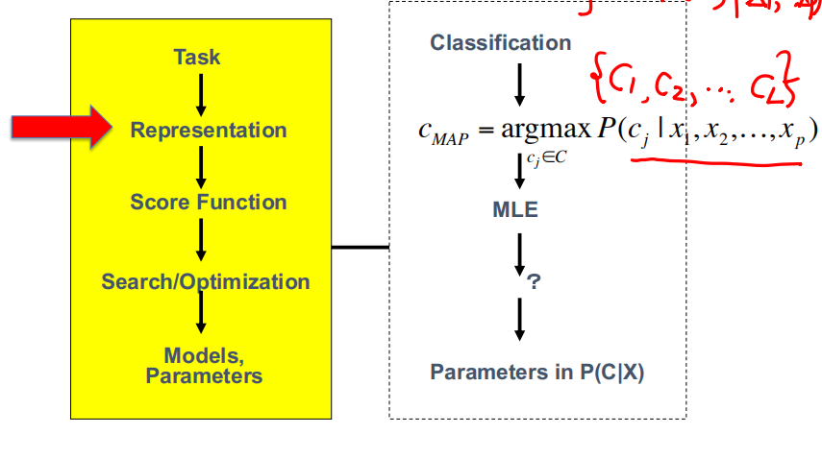
Bayes Classifier

Slide 5
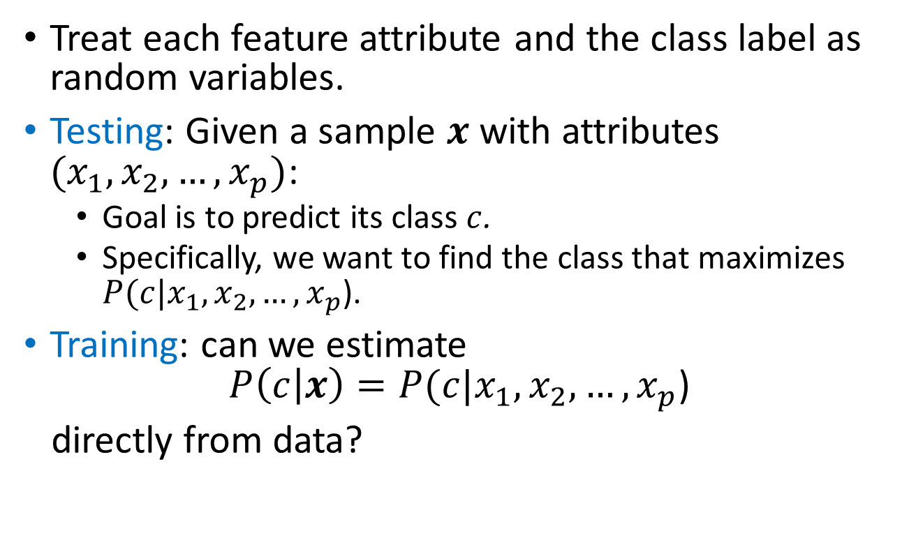
Bayes Classifiers
Treat each feature attribute and the class label as random variables.
Testing: Given a sample $x$ with attributes $(x_{1},x_{2},…,x_{p})$:
Goal is to predict its class $c$.
Specifically, we want to find the class that maximizes $P(c|x_{1},x_{2},…,x_{p}$).
Training: can we estimate
$$P\left(c | x\right)=P(c|x_{1},x_{2},…,x_{p}\text{)}$$
directly from data?

Slide 6
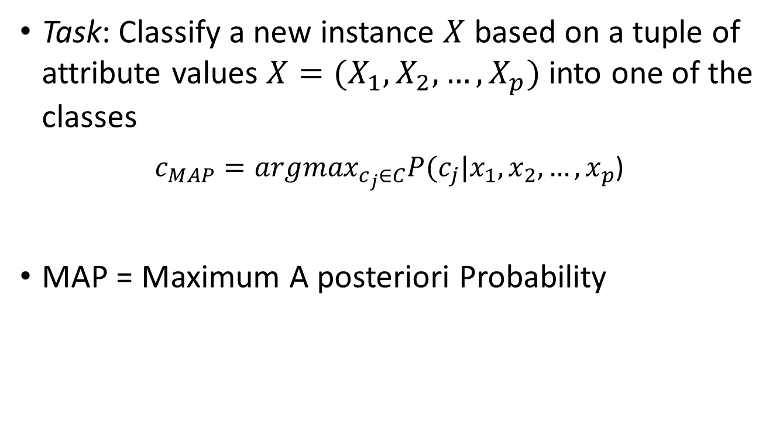
Bayes Classifiers – MAP Rule
Task: Classify a new instance $X$ based on a tuple of attribute values $X=(X_{1},X_{2},…,X_{p})$ into one of the classes
$c_{MAP}={argmax}_{c_{j}∈C}P(c_{j}|x_{1},x_{2},…,x_{p}$)
MAP = Maximum A posteriori Probability

Slide 7
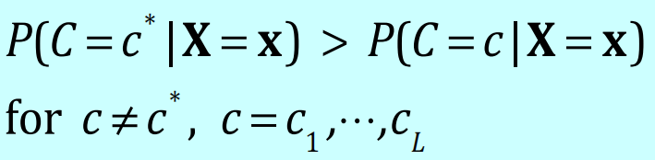
Bayes Classifiers – MAP Classification Rule
Establishing a probabilistic model for classification → MAP classification rule
MAP: Maximum A Posterior
Assign x to c* if

Slide 8
Review: Statistical Decision Theory
Random input vector: X
Random output variable: Y
Joint distribution: Pr(X,Y )
Loss function L(Y, f(X))
Expected prediction error (EPE):
EPE( f ) = E(L(Y, f (X ))) = ∫ L(y, f (x))Pr(dx, dy)
e.g. = ∫ (y − f (x))² Pr(dx,dy)
Consider population distribution
e.g. Squared error loss (also called L2 loss)

Slide 9








Review: EPE with different loss
Loss Function | Estimator
L₂
L₁
0-1 | (Bayes classifier / MAP)

Slide 10

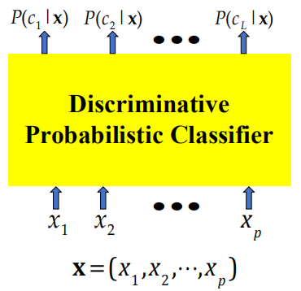
Today: Discriminative model

Slide 11
Today
Bayes Classifier
Logistic Regression
Training LG by MLE

Slide 12
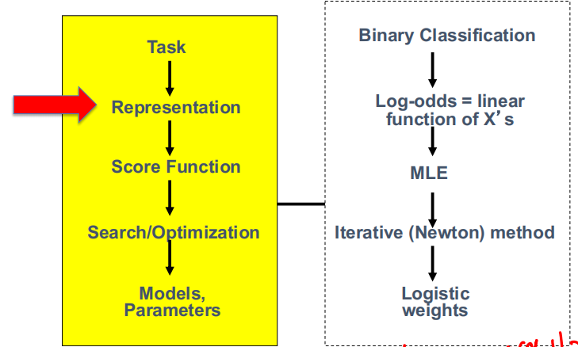
Logistic Regression

Slide 13

Multivariate linear regression to Logistic Regression
$$y=β_{0}+β_{1}x_{1}+β_{2}x_{2}+…+β_{p}x_{p}$$
$$ln⁡[\frac{P\left(y | x\right)}{1−P(y|x)}]=β_{0}+β_{1}x_{1}+β_{2}x_{2}+…+β_{p}x_{p}$$
Logistic regression for binary classification

Slide 14
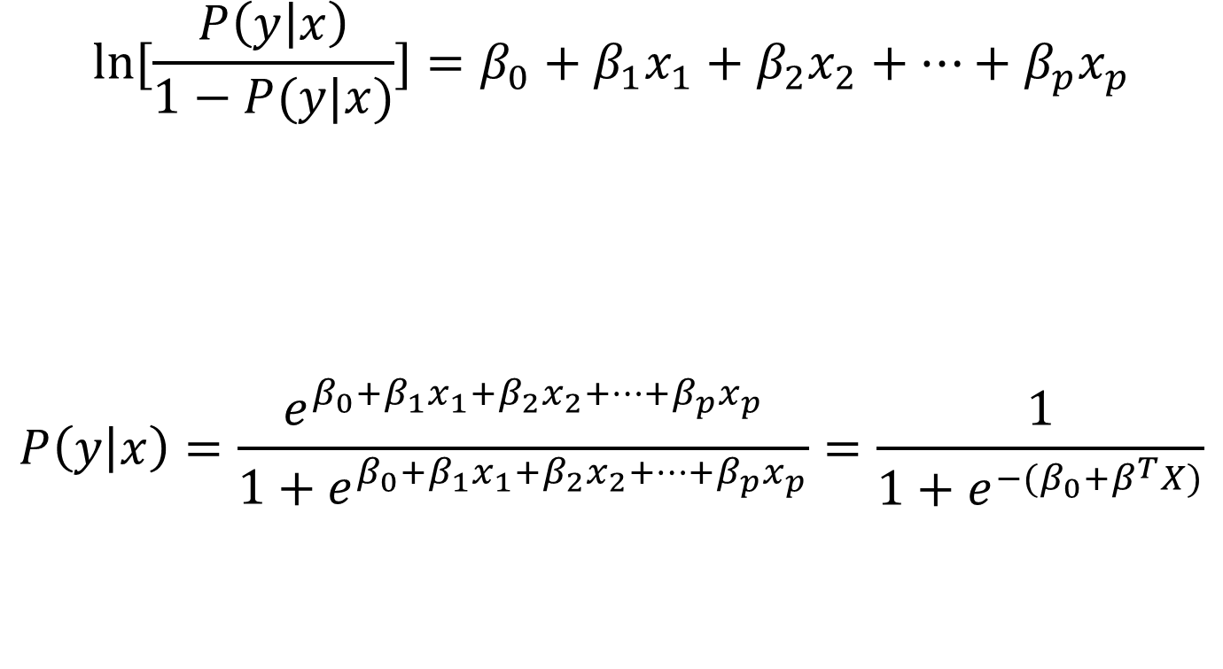
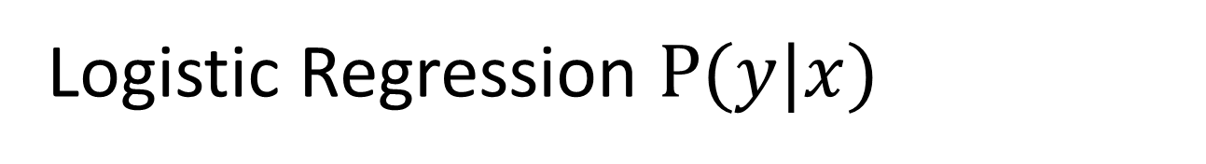
Logistic Regression $P(y|x)$
$$ln⁡[\frac{P\left(y | x\right)}{1−P(y|x)}]=β_{0}+β_{1}x_{1}+β_{2}x_{2}+…+β_{p}x_{p}$$
$$P\left(y | x\right)=\frac{e^{β_{0}+β_{1}x_{1}+β_{2}x_{2}+…+β_{p}x_{p}}}{1+e^{β_{0}+β_{1}x_{1}+β_{2}x_{2}+…+β_{p}x_{p}}}=\frac{1}{1+e^{{−(β}_{0}+β^{T}X)}}$$

Slide 15
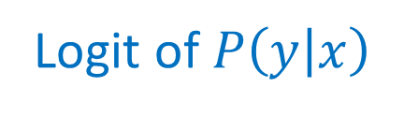

The logit function View (e.g. when with 1D x)
$$P\left(y | x\right)=\frac{e^{α+βx}}{1+e^{α+βx}}$$
$$ln⁡[\frac{P\left(y | x\right)}{1−P(y|x)}]=α+βx$$
Logit function
Logit of $P\left(y | x\right)$

Slide 16
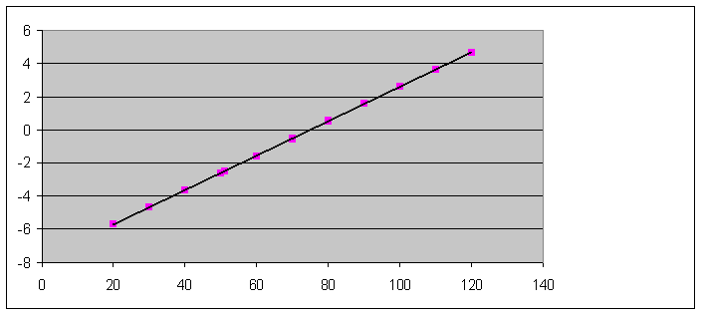

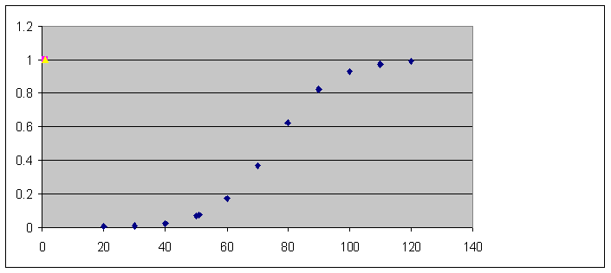

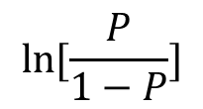

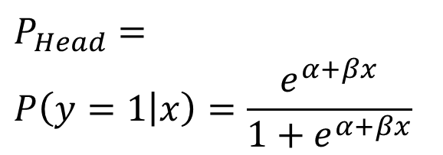


Binary Logistic Regression: Three Views
$$ln⁡[\frac{P}{1−P}]$$
Bernoulli distribution
$$y∈\{0, 1\}$$
x
$$P(y=1|x)$$
$$P(y=1|x)$$
$$1−P(y=1|x)$$
$$P_{Head}=$$
$$P\left(y=1 | x\right)=\frac{e^{α+βx}}{1+e^{α+βx}}$$
x

Slide 17
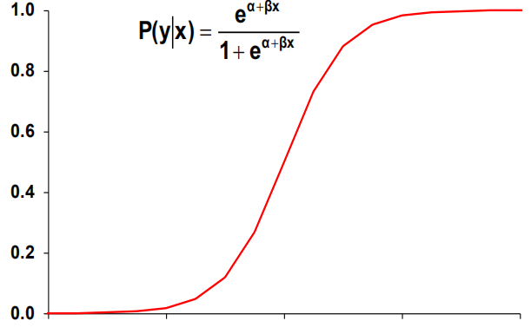



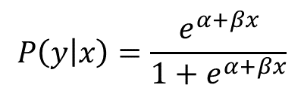
Binary Logistic Regression (Three Views)
View I: logit of $P(y=1|x)$is linear function of x
$$P\left(y=1 | x\right)$$
$$P\left(y | x\right)=\frac{e^{α+βx}}{1+e^{α+βx}}$$
$$x$$

Slide 18
Binary Logistic Regression (Three Views)
View II: "S" shape function compress output to [0,1]
$$P\left(y=1 | x\right)$$
$$P\left(y | x\right)=\frac{e^{α+βx}}{1+e^{α+βx}}$$
$$x$$

Slide 19

Binary Logistic Regression (Three Views)
View III: Logistic Regression models a linear classification boundary
$$y∈\left\{0, 1\right\}$$
$${argmax}_{y∈\left\{0, 1\right\}}P(y|x\text{)}$$
$P(y=0|x\text{)}=P(y=1|x\text{)}$ ➔ $\frac{P(y=1|x)}{P(y=0|x)}=1$
$$\log\left[\frac{P\left(y=1 | x\right)}{P\left(y=0 | x\right)}\right]={\vec{β}}^{T}\vec{x}=\log\left(1\right)=0$$

Slide 20

Binary Logistic Regression (Three Views)
View III: Logistic Regression models a linear classification boundary
$$y∈\left\{0, 1\right\}$$
$$ln⁡[\frac{P\left(y | x\right)}{1−P(y|x)}]=β_{0}+β_{1}x_{1}+β_{2}x_{2}+…+β_{p}x_{p}$$
$$\ln\left[\frac{P\left(y=1 | x\right)}{P\left(y=0 | x\right)}\right]=\ln\left[\frac{P\left(y=1 | x\right)}{1−P\left(y=1 | x\right)}\right]$$
$=β_{0}+β_{1}x_{1}+β_{2}x_{2}+…+β_{p}x_{p}$
Decision Boundary ➔ equals to zero

Slide 21
When to use Logistic Regression?
Logistic regression models are appropriate when the target variable is coded as 0/1.
We only observe “0” and “1” for the target variable, but we think of the target variable conceptually as a probability that “1” will occur.

Slide 22
Logistic Regression Assumptions
Linearity in the logit – the regression equation should have a linear relationship with the logit form of the target variable.
There is no assumption about the feature variables / target predictors being linearly related to each other.
$$P(y=1|x)$$
$$1−P(y=1|x)$$

Slide 23
Today
Bayes Classifier
Logistic Regression
Training LG by MLE

Slide 24
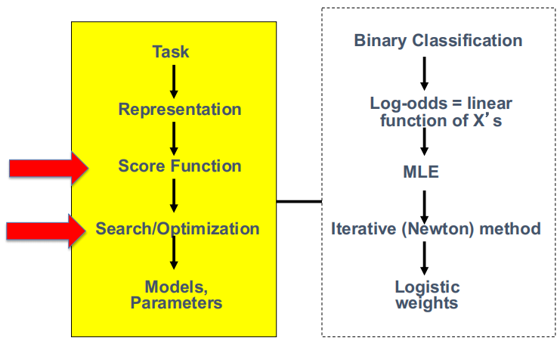
Logistic Regression

Slide 25
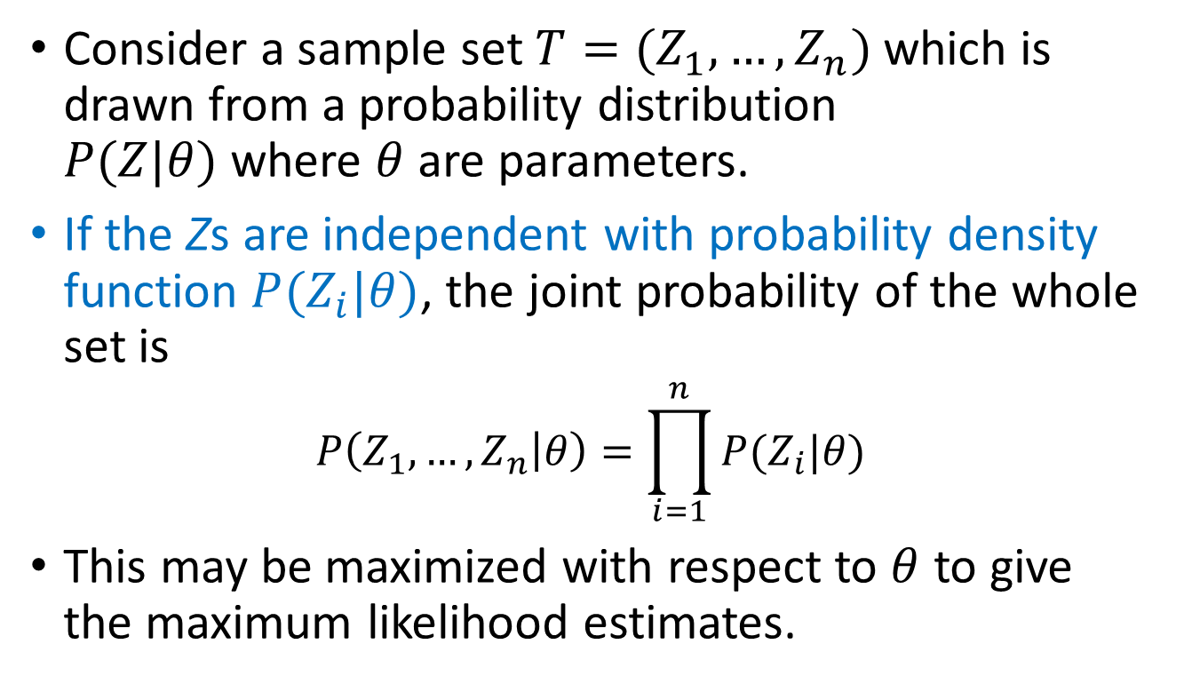
Review: Maximum Likelihood Estimation
Consider a sample set $T=(Z_{1},…,Z_{n})$which is drawn from a probability distribution $P(Z|θ)$where $θ$ are parameters.
If the Zs are independent with probability density function $P(Z_{i}|θ)$, the joint probability of the whole set is
$$P\left(Z_{1},…,Z_{n} | θ\right)=\prod_{i=1}^{n}{P(Z_{i}|θ)}$$
This may be maximized with respect to $θ$ to give the maximum likelihood estimates.

Slide 26
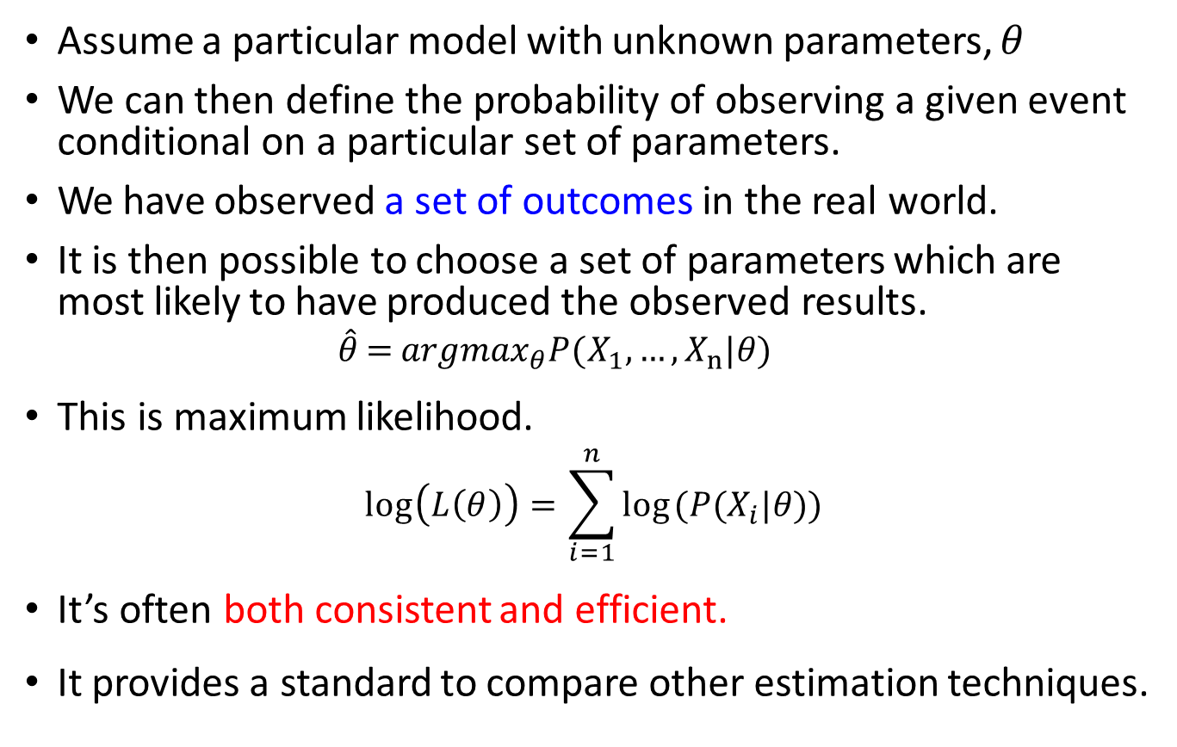
Review: Maximum Likelihood Estimation
Assume a particular model with unknown parameters, $θ$
We can then define the probability of observing a given event conditional on a particular set of parameters.
We have observed a set of outcomes in the real world.
It is then possible to choose a set of parameters which are most likely to have produced the observed results.
$$\hat{θ}={argmax}_{θ} P(X_{1},…,X_{n}| θ )$$
This is maximum likelihood.
$$\log\left(L\left(θ\right)\right)=\sum_{i=1}^{n}{log⁡(P(X_{i}| θ))}$$
It’s often both consistent and efficient.
It provides a standard to compare other estimation techniques.
Likelihood
Log-Likelihood

Slide 27
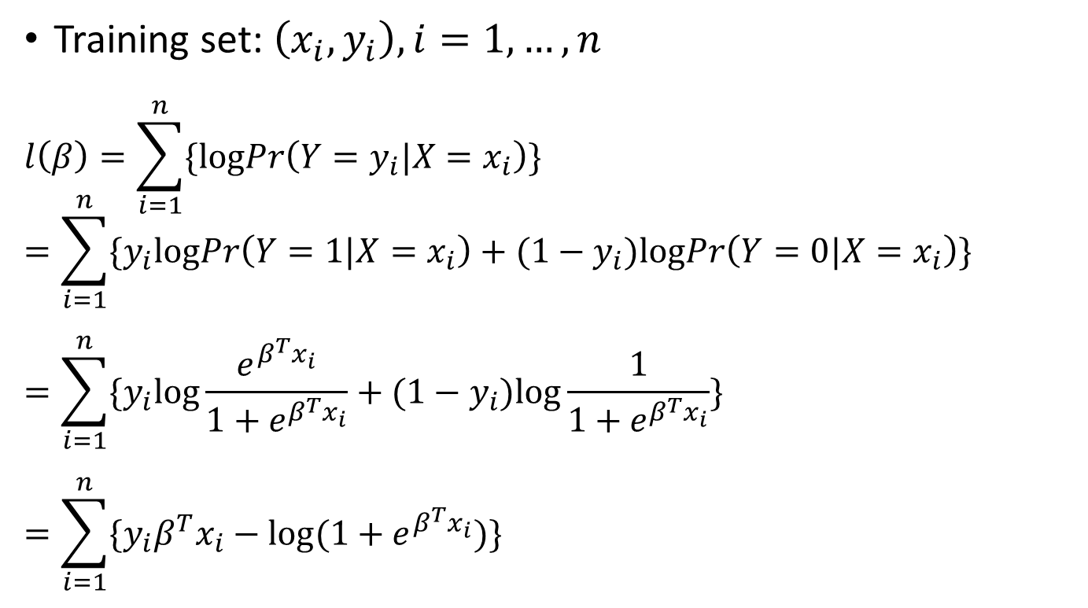
MLE for Logistic Regression Training
Training set: $\left(x_{i}, y_{i}\right), i=1,…,n$
$$l\left(β\right)=\sum_{i=1}^{n}{\{logPr\left(Y=y_{i}|X=x_{i}\right)\}}$$
$$=\sum_{i=1}^{n}{\{y_{i}logPr\left(Y=1|X=x_{i}\right)+(1−y_{i})logPr\left(Y=0|X=x_{i}\right)\}}$$
$$=\sum_{i=1}^{n}{\{y_{i}log\frac{e^{β^{T}x_{i}}}{1+e^{β^{T}x_{i}}}+(1−y_{i})log\frac{1}{1+e^{β^{T}x_{i}}}\}}$$
$$=\sum_{i=1}^{n}{\{y_{i}β^{T}x_{i}−log(1+e^{β^{T}x_{i}})\}}$$

Slide 28
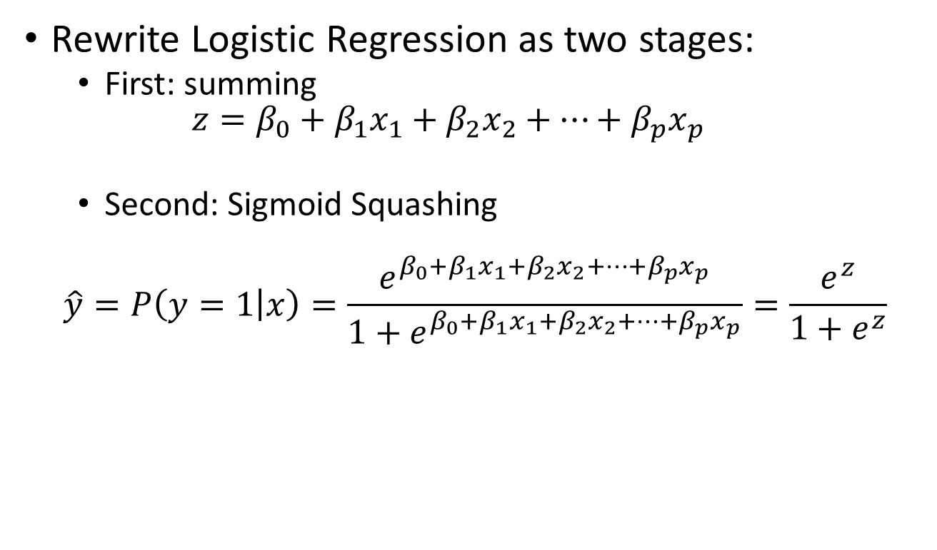
Extra
Rewrite Logistic Regression as two stages:
First: summing
$$z=β_{0}+β_{1}x_{1}+β_{2}x_{2}+…+β_{p}x_{p}$$
Second: Sigmoid Squashing
$$\hat{y}=P\left(y=1 | x\right)=\frac{e^{β_{0}+β_{1}x_{1}+β_{2}x_{2}+…+β_{p}x_{p}}}{1+e^{β_{0}+β_{1}x_{1}+β_{2}x_{2}+…+β_{p}x_{p}}}=\frac{e^{z}}{1+e^{z}}$$

Slide 29
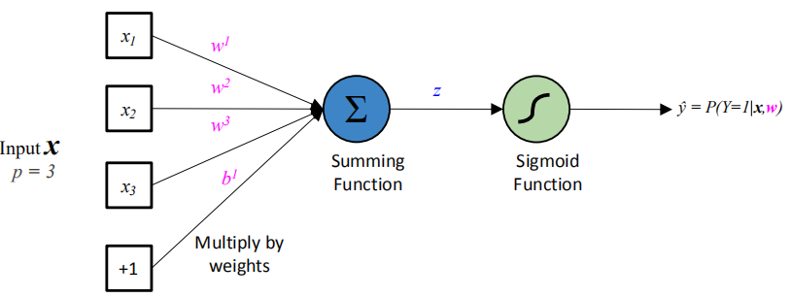
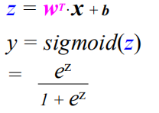
“Neuron”: Block View of Logistic Regression

Slide 30
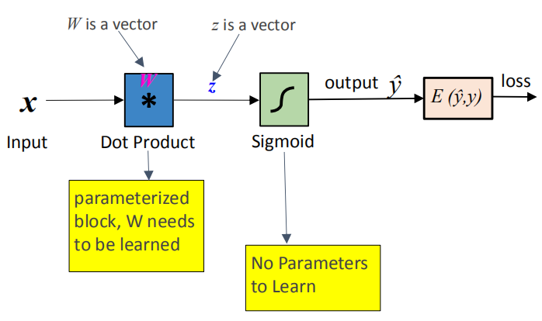
e.g., “Block View” of Logistic Regression

Slide 31
Three major sections for classification
Discriminative
directly estimate a decision rule/boundary
e.g., support vector machine, decision tree, logistic regression
e.g. neural networks (NN), deep NN
Generative
build a generative statistical model
e.g., Bayesian networks, Naïve Bayes classifier
Instance based classifiers
Use observation directly (no models)
e.g. K nearest neighbors

Slide 32
References
https://qiyanjun.github.io/2019f-UVA-CS6316-MachineLearning/
Prof. Tan, Steinbach, Kumar’s “Introducoon to Data Mining” slide
Prof. Andrew Moore’s slides
Prof. Eric Xing’s slides
Prof. Ke Chen NB slides
Hasoe, Trevor, et al. The elements of sta8s8cal learning. Vol. 2. No. 1. New York: Springer, 2009.

Slide 33
Thanks for listening

